Slide 1

Salesforce Project
Dan Bennett

Slide 2
The Project
Broken down into two phases.
Phase one focused on declarative features.
Phase two focused on programmatic features.
Notes:
The project was to be a Course Instructor system used to keep track of courses and invoices for different instructors. There was two phases of this project. Phase 1 focused on declarative features and setting up the simple aspects of the project such as profiles,roles and general security settings. The second phase was focused on programmatic features using apex and visualforce to add functionality to the system.

Slide 3
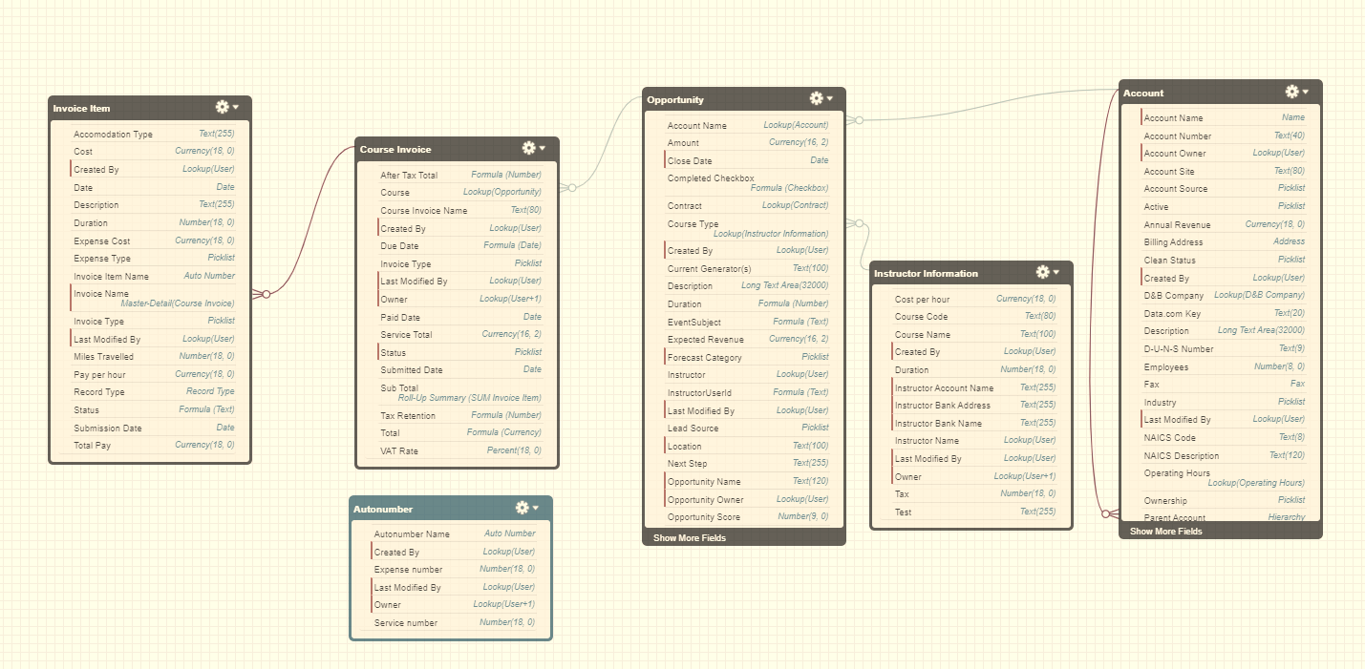
Schema
Notes:
This is the schema of the main aspects of the system. This shows the layout of the system. The opportunity object is the main object which was renamed to Courses. Instructor information contains records for each instructor for each course. Basically each instructor will have a record for ADX201,ADX211,DEX403,ADX231 and DEX450. Course Invoices are created for each course. Service invoices are created automatically and expense invoices need to be created manually. The same applies to Line items for each invoice which are contained in Invoice Item. Account doesn't have too much customisation within the project but would be used in day to day usage.

Slide 4
For this project
Technologies used:
Salesforce declarative features
APEX code
Visualforce
CSS
Notes:
One the key technologies used in this project were salesforce declarative features which consisted of Flows, Processes , approval processes aswell as many other features.
Apex code was used to expand the range of customisation.
Visual force was used to create custom pages outside of the standard salesforce functionality
Cascading Style Sheets added in here as it’s a new technology I had to learn for this specifically

Slide 5
Demonstration

Slide 6
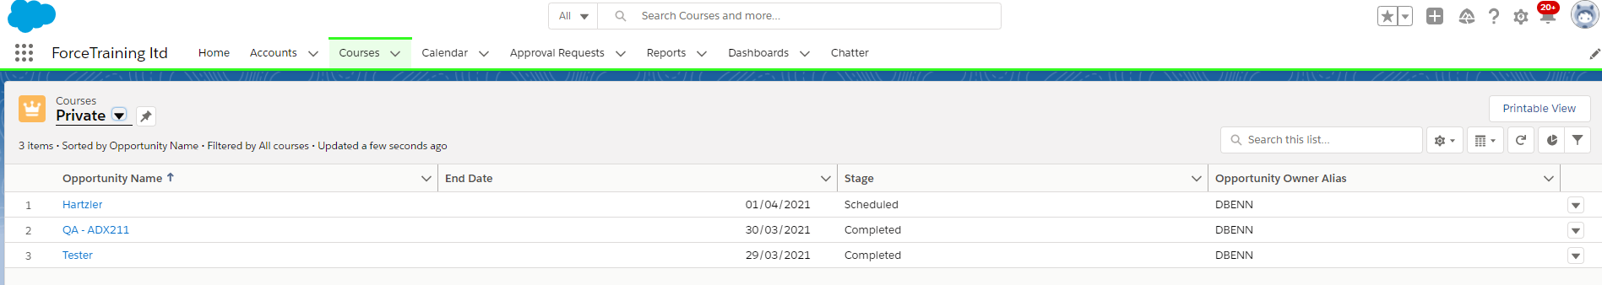
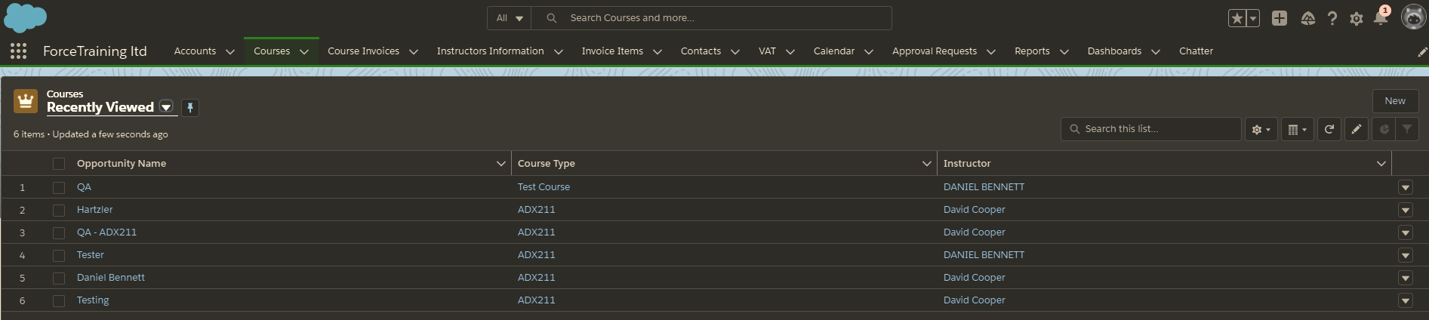

Slide 7
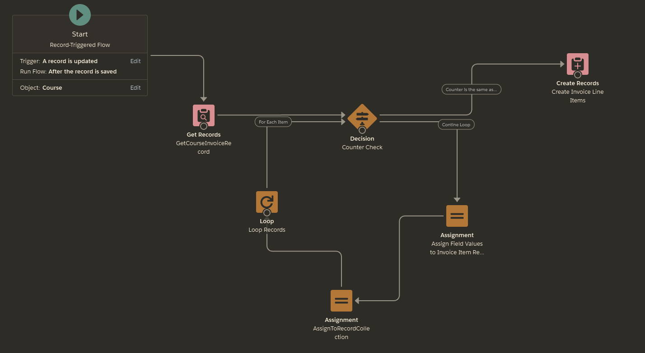
Course Service Invoice Line Items Automation

Slide 8
Further improvements
Create an easy way to clone previous expense invoices
Finish test code
PDF style improvements

Slide 9
Self-Reflection
Learnt a large amount about Salesforce
Apex Developer Guide is a great addition tool

Slide 10
Any Questions?

